Slide 1

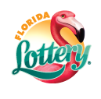
THE POWER OF
Tom Delacenserie
Secretary, Florida Lottery

Slide 2

What it’s Like to be Part of the National Consciousness
Superbowl, Olympics, World Cup Soccer
Christmas, 4th of July, Halloween

Slide 3
How is Powerball Different
A product sold at retail
Already part of the National Consciousness
Awareness potential intensifies nationally/worldwide
  At peak on 1/13/16, The Florida Lottery recorded hourly draw
  sales of $1,780 per second, sales of $106,829 per minute and sales
  of $6,409,731 per hour. Total draw sales for the day were $55,195,858
  and total sales for the draw were $108,097,227.
Media comes to us - $100M estimated free advertising – last
two weeks of record jackpot.

Slide 4
What a Record Looks Like
Peak hours (6 p.m. to 7 p.m. on 1/13/16):
Sales Per Hour $6,409,731 Tickets Per Hour 2,980,525
Sales Per Minute $106,829 Tickets Per Minute 49,675
Sales Per Second $1,780 Tickets Per Second 828
Final Day (1/13/16):
Sales $55,484,630 Tickets 25,776,655
Total Roll Series (11/5/15-1/13/16):
Sales $283,678,124 Tickets 131,106,442

Slide 5
Luck – Results When Preparation Meets Opportunity
Continually reminds retailers of POWERBALL’S effect
Some retailers doubled their average weekly total sales
Some retailers erased 6 months of red ink
All improved dollars going to their bottom line
Discuss opportunities realized/lost – plan for next time
Ride the crest of the wave long after the tsunami

Slide 6
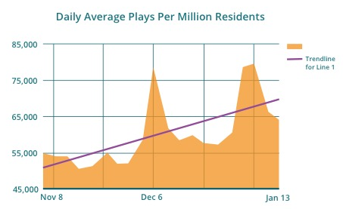
High Tide Raises All Ships
Use POWERBALL to keep the focus on the category
Compare our success to other category growth, dollars per
square foot
Increased awareness always increases sales

